Slide 1
Data Analysis (loan Dataset)
By GAURAV BINJOLA

Slide 2
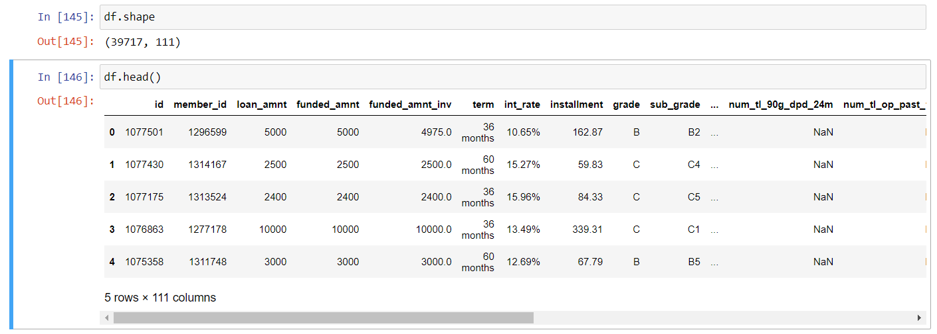
About Data
Data contains 111 columns and 39717 rows.
This Data tells us about the customers who has paid all installments of the loan as fully paid and the ones who has not as charged off and the going on loans are as current.
This data contains the details of customers who has taken the loan and there loan status.

Slide 3
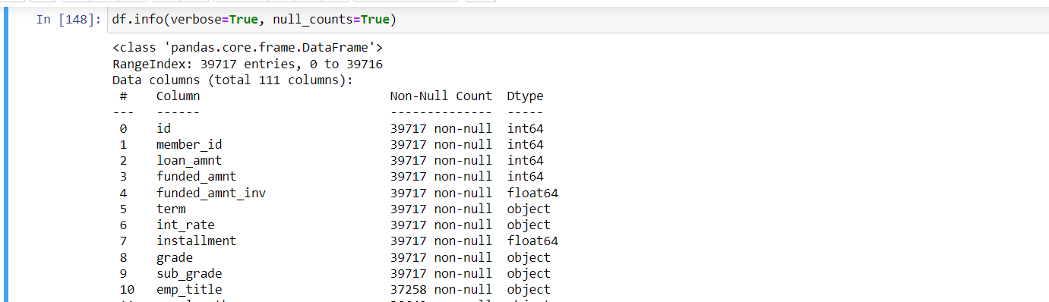
Missing Values Treatment
We have to deal with the missing values and set values in that block if the data of a row or column has more that 50% missing values so we remove that particular column or row.
We will get to know about the missing values for all columns buy .info method in pandas.
In the image below we can see that the .info contains the Non-null values and Data type also so we can check which kind of data present in that particular column.

Slide 4
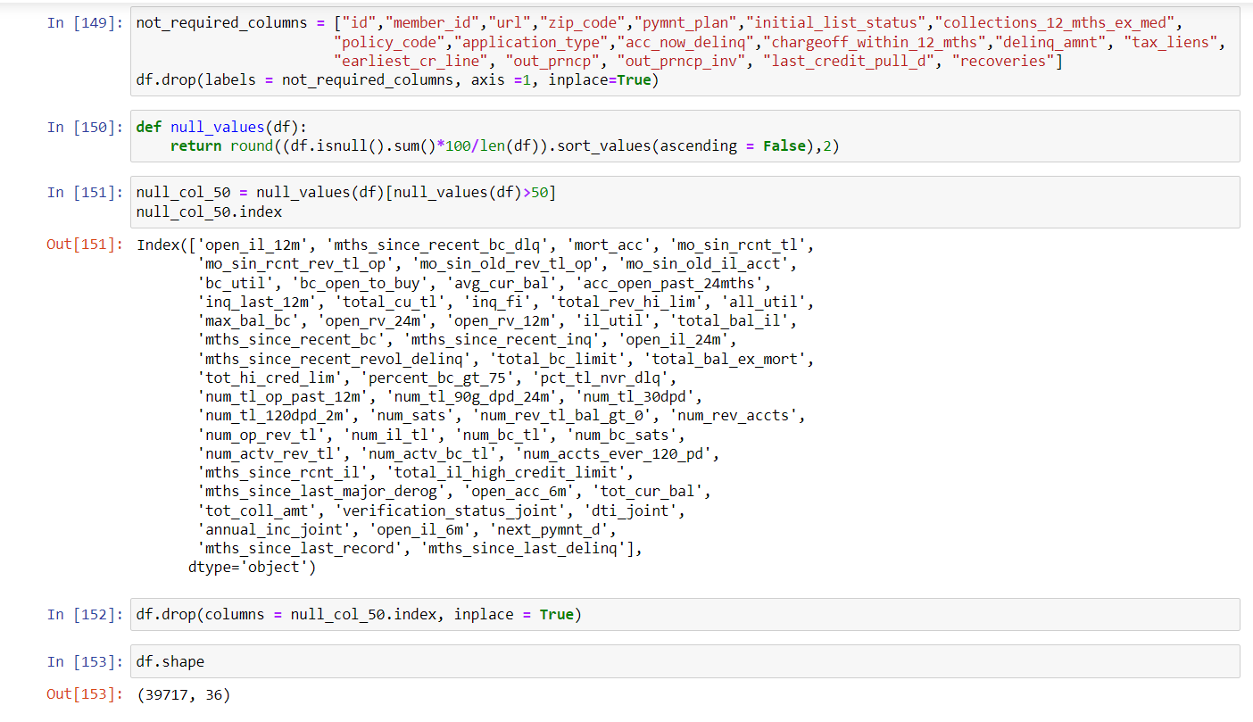
Treatment of columns
Now we will check for the columns that contains more that 50% of missing values and then remove that columns from the dataset.
We will also remove the columns that have the information which will not required for the analysis.
Here First we have removed the column that are not required for our analysis (not_required_columns).
Than we find the columns which have more than 50% of missing value and that with the help of .drop we have remove all the columns and at last we have 36 columns remaning in the dataset.

Slide 5
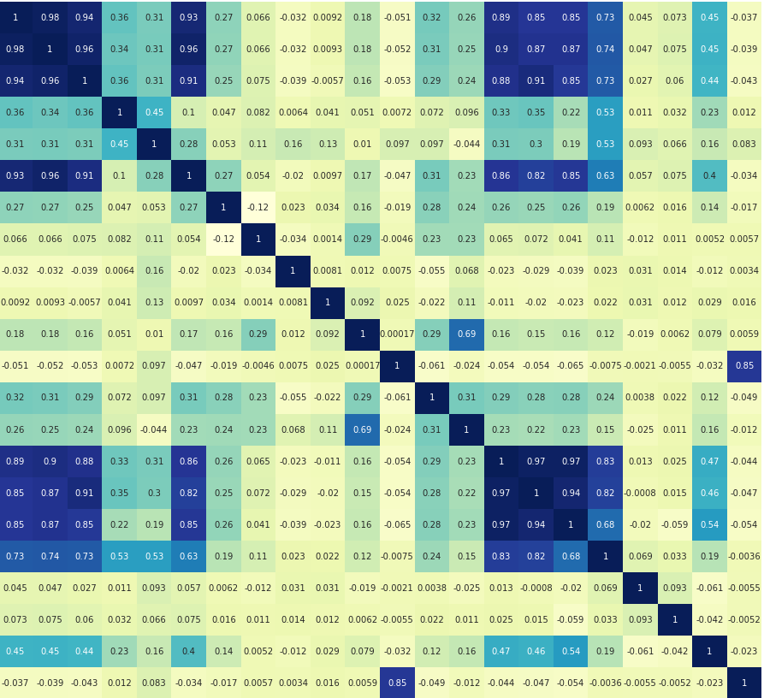
Analysis
First we will check the correlation between all the columns and check if there is problem of multicollinearity.
This the way Graph looks like and it tell us the correlation between two columns.
Every block number and color tell how the two columns are correlated. For Eg : if a block has 0.98 (no.) and dark blue color that means the two columns are highly correlated with each other.
Now there are two ways to deal with the multicollinearity in the dataset:
1. we will leave the columns as it is and don’t
change the values.
2. we can remove the column which are highly
correlated with each other. In this we age going to
remove column with more then 90% of
correlation

Slide 6
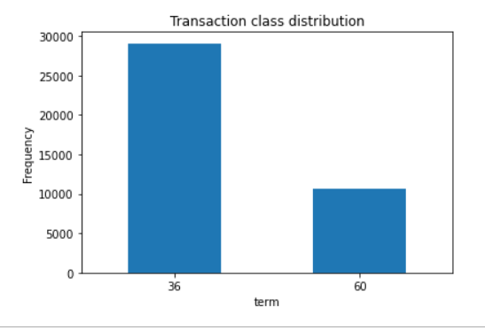
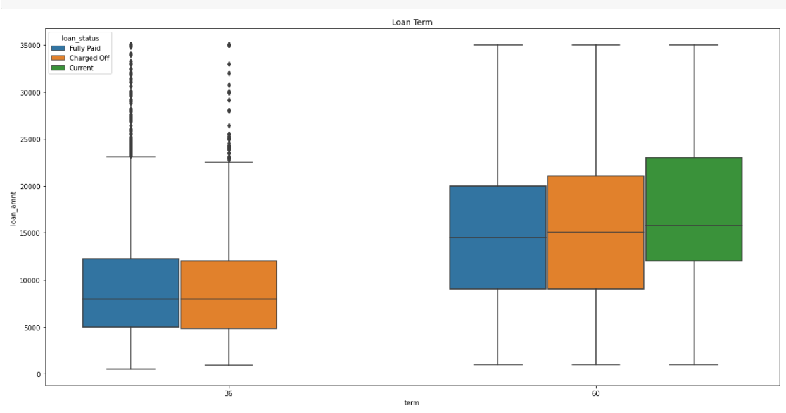
In the first imange we can see the distribution with the term i.e. time period of loan.
Here we can see that more customers takes loan with time period of 36 months than the customers who takes for 60 months .
There are around 40000 entries and more that 28000 are of 36 month of time period.
In the second image we can see the distribution of term with the loan status i.e. Fully paid, Charge Off and Current.
There are no current going loan in 36 months of term so we can assume that customers are going towards 60 months term period now.
The median of 36 month is also lower than the 60 month term. And maximum percentile range of 30 is lower that 60.

Slide 7
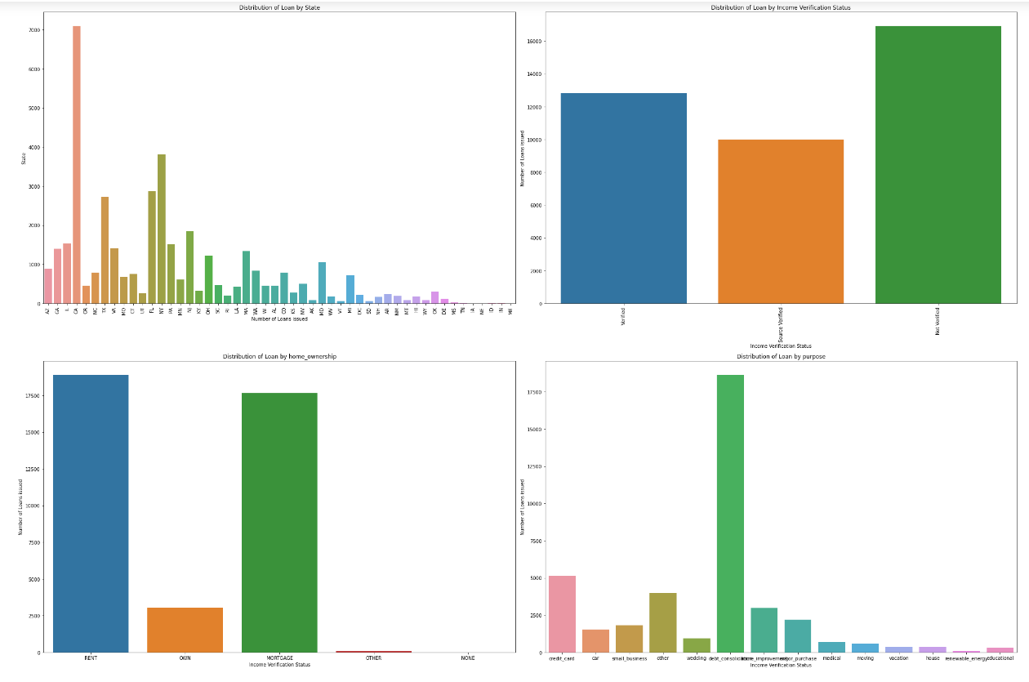
Maximum loans are applied and approved are from the city CA.
We can also see that most of the customers were not verified.
Maximum customers have House ownership as rent or mortgage so we cannot get there property if they don’t pay the loan amount with charges.
Some of the states or city has very less number of loans and customers who has owned house has less probability to take loan than the others.
While not verifying customers we are increasing our charge off chances also.
we can assume that cities or states with less customers are more richer than other as they don’t take loans or they are less educated and has fear to take loan.

Slide 8
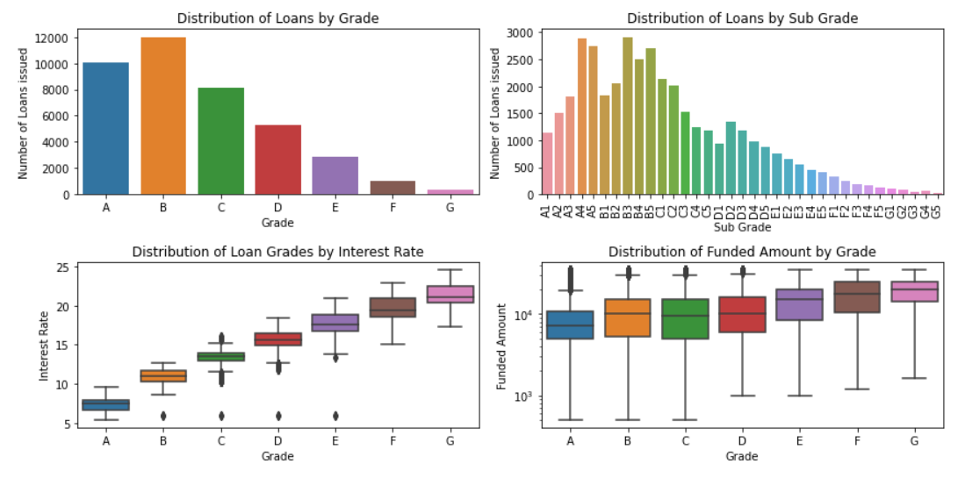
Here we can see that the loan takes buy upper grade customers are more than the lower grade. We can assume that happens because of the interest rate charges.
Interest rate for upper grade if much lower than the lower grade that’s why lower grade customers hesitate to take loan.
The Distribution in the Grade and Sub grade is Quite similar. But its clear that from grade A4 to B5 the count of loans is very high or we can say that maximum number of loans is from that area.

Slide 9
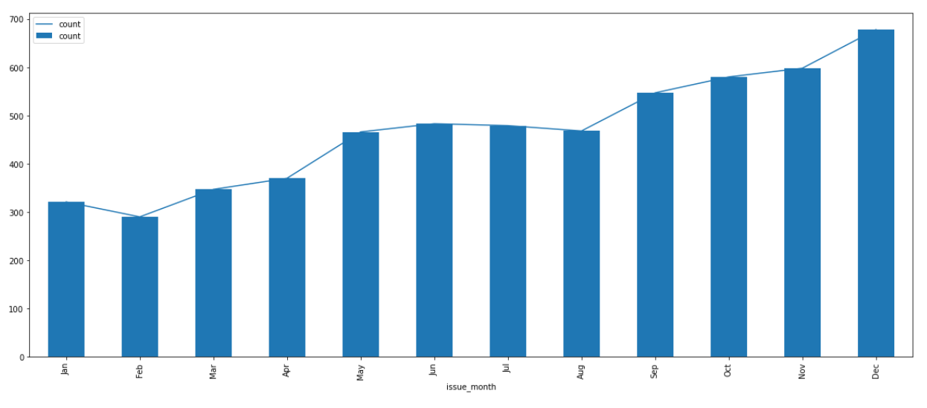
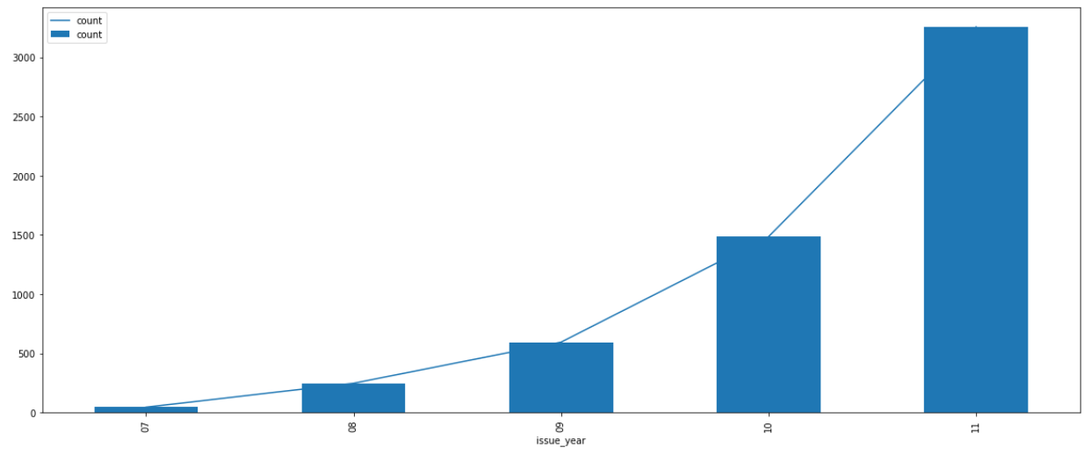
loan applicants are increasing year on year, and the difference in 2010 and 2011 id more than double of 2010 .
The distribution of loans in months are nearly similar in starting months (Jan-Apr) and (May-Aug).
The loan count in 2011 is very high than other years.

Slide 10
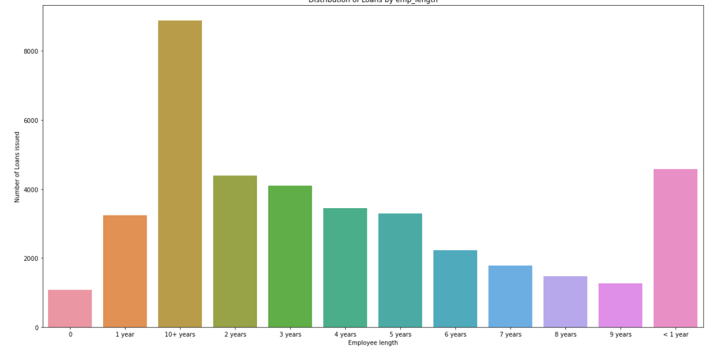
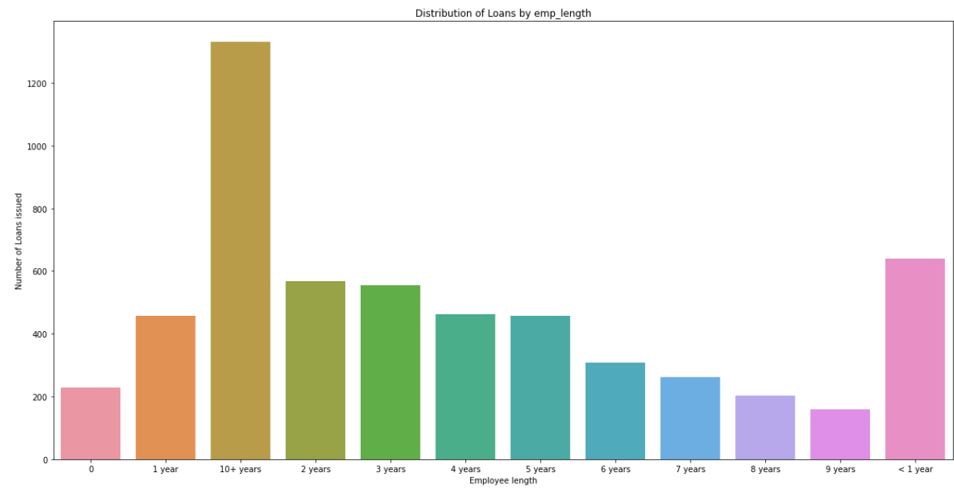
The First Image is the distribution of employee length with the all entries and the second image is the distribution of employee length with the only charge off entries.
In the first image we can see that the 10+ years has takes maximum loan than the other and the charge off of the 10+ year is also maximum.
We can see that the distribution in all entries and the charge off entries is quite similar but there are difference is in number of loan issued.
The charge of 2 years, 3 years, <1 year, 1 years, 4 years are almost same and the number of loan issued is also same for all these length.

Slide 11
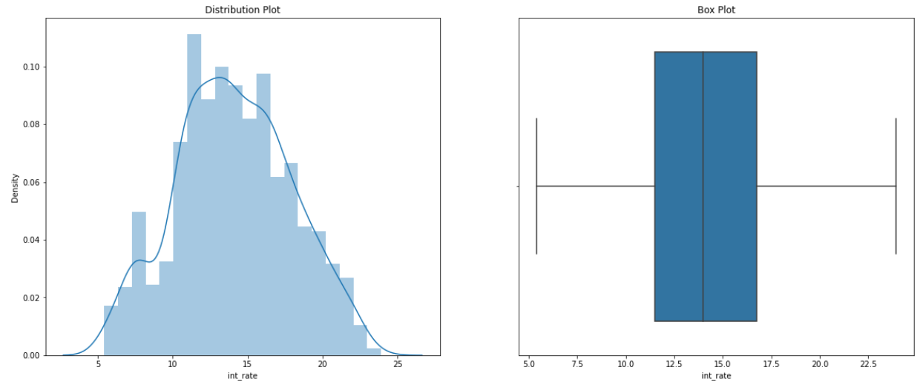
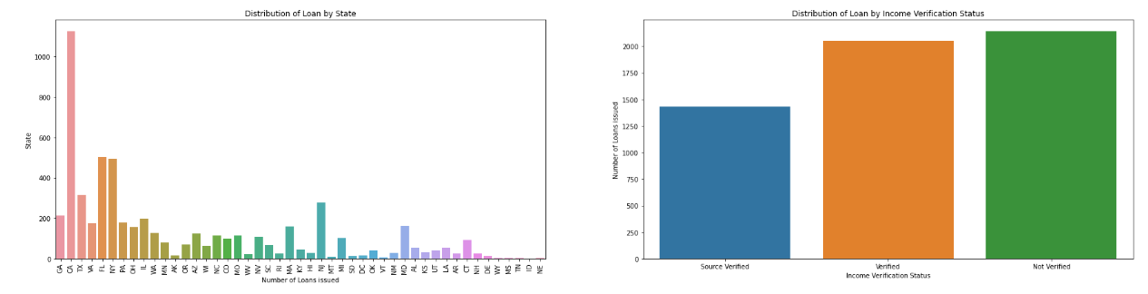
Now we are going to analysis of charge off entries.
We can see that interest rate between 12% to 16% has the maximum charge off.
The state CA has the maximum charge off compare to the others.
There are maximum entries with Not verified with total of approx 3500.

Slide 12
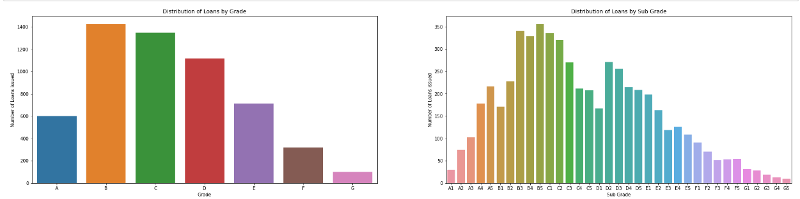
The charge off entries are more in the B and C Grade and the range of Sub Grade between b3 to c2 has the maximum charge off entries.
The charge off entries in G grade and Sub Grade between G1 to G5 has the lowest charge off entries. But the number of loans provided buy the company to these grade are also less in numbers.
The analysis tells that the more the loan are provided to some particular area the more the chance of charge off entry in that area.

Slide 13
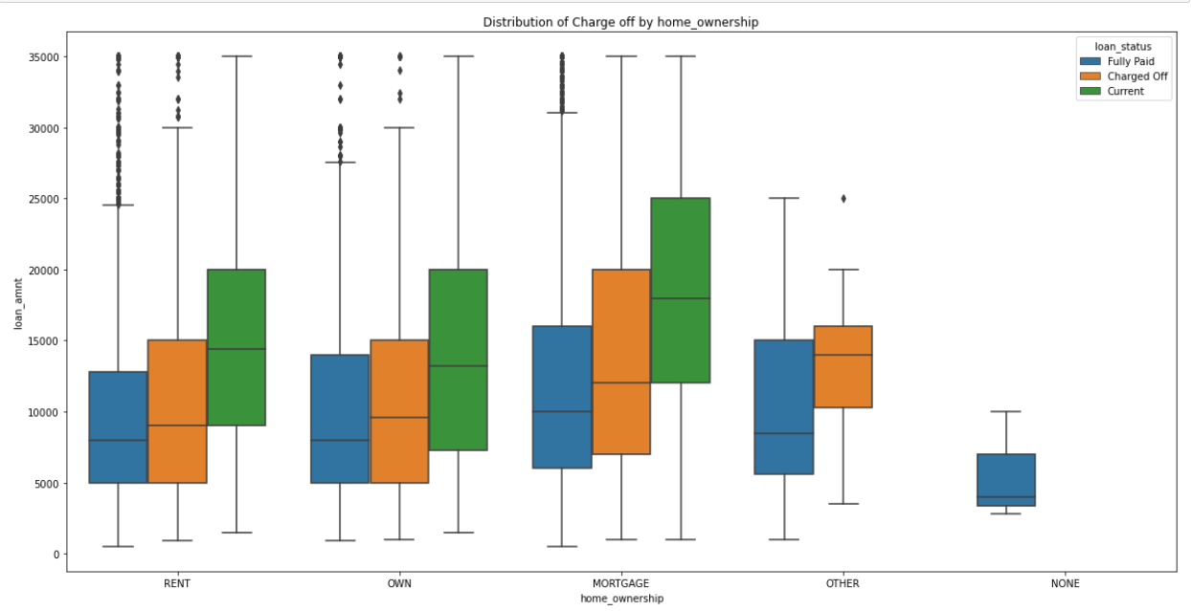
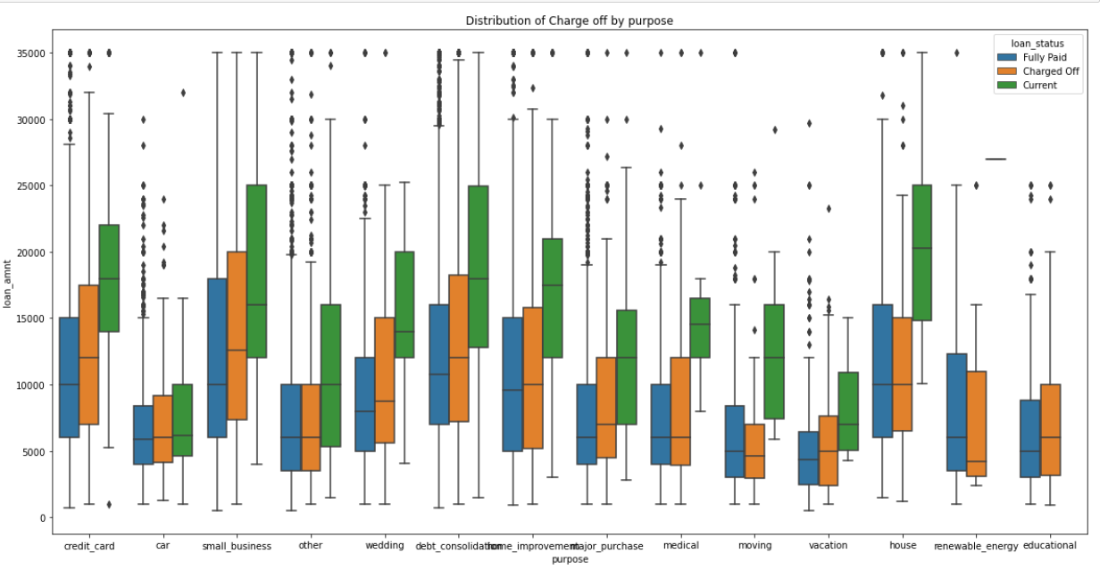
Applicants who has taken the Loan for 'small business‘ and ‘credit card’ has the highest probability of charge off. So bank should take extra caution like take some asset while approving the loan for purpose of 'small business‘.
There are no charge off in the None for Ownership of house but that does not mean that we can approve loan to the one who has No ownership status we should verify the customer and they should have some king of ownership to show.
The charge off of the ‘Other’ in Home ownership is the max and that should be also take care with the verification and have some asset for the recovery of loan amount.

Slide 14
THANK Y

